Slide 1


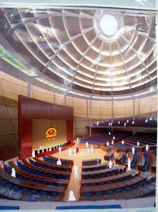
Chính phủ điện tử
TS. Phạm Văn Tính
Khoa CNTT, ĐH Nông Lâm TP.HCM
pvtinh@hcmuaf.edu.vn

Slide 2
Outlines
Overview of JSF 2.0
Required software
Installing Java SE 6
Installing Eclipse 4.2
Installing a server for JSF 2.0
Basic JSF Programming
Basic Structure of JSF 2.0 Application
Testing projects: Step by Step
Required JSF 2.1 and JSTL 2.0 libraries

Slide 3
Overview of JSF 2.0
JSF 2.0 adds many new features
Smart defaults
Annotations to replace many faces-config.xml entries
Ajax support
Integrated support for facelets
Simpler custom components
More components and validators
Lots more

Slide 4
Required software
JDK 1.6
JSF 2.x
Tomcat 6.0 or 7.0
Eclipse 4.2

Slide 5
Basic JSF Programming
Create JSF Project
Enable JSF 2.x capabilities – Manage Libraries
Create JSF Page
XHTML file
JSF Page Structure
Create / Use Template
Basic JSF Component
Managed beans
Structure of managed beans
Relationship between JSF page and managed bean

Slide 6
Basic JSF Programming
Navigation
Static
Dynamic
Converting and Validating data
Component Event Handling
Backing bean
User Interface Component Model
Data Table
CSS
Complex Table using backing bean and UI Component
JSF and AJAX

Slide 7
JSF Application Architecture
An entry in the Web application’s web.xml file enables the Faces Controller servlet when a certain URL pattern is specified, such as /faces/*. When running JSF 2.0 on a Servlet 3.0 container, the web.xml is optional. If no web.xml is found, the Faces Controller servlet is automatically mapped to the most popular URL patterns: /faces/*, *.jsf, and *.faces.
An optional JSF configuration file, faces-config.xml, allows for configuration of all elements of a JSF application. JSF has Java annotations for nearly everything that can be put in to the faces-config.xml, obviating the need for the file in most cases. This file is treated as a peer of the web.xml file and is usually located in the Web application’s WEB-INF/ directory.

Slide 8
JSF Application Architecture
Once a Java EE Web application is properly configured for JSF, you can construct the View using Facelets XHTML pages. (Versions of JSF prior to 2.0 emphasized JSP as the page declaration language. JSPs are indeed still supported in JSF 2.0, but few of the features unique to 2.0 are available to pages built with JSP.
For an XHTML page to be JSF-enabled, it must first contain JSF XML namespace directives provided by a JSF implementation. The following namespace directives are for the Core and HTML libraries available from all JSF implementations:
<html xmlns=http://www.w3.org/1999/xhtml
xmlns:h=http://java.sun.com/jsf/html
xmlns:f="http://java.sun.com/jsf/core">

Slide 9
JSF Application Architecture
Because this is XHTML, the HTML elements must be in all lowercase and must always be balanced. If the page processes form input, as opposed to just displaying output, you’ll need to add a <h:form> tag as a child of the <body> or <h:body> tag. Subsequent child tags of the <h:form> tag will become the form elements such as <h:inputText>, which renders an input field, and <h:commandButton>, which renders a form submission button.

Slide 10
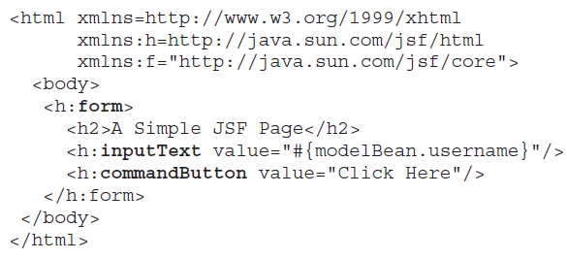
JSF-enabled XHTML page

Slide 11
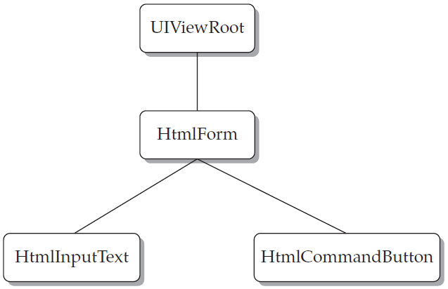
The JSF Request Processing Lifecycle
When a JSF-enabled XHTML page is requested or when the user invokes an action on a UI component in a JSF-enabled XHTML page, it is important to understand the exact sequence of events that occur on the server in order to fulfill the request to view or submit a JSF page

Slide 12
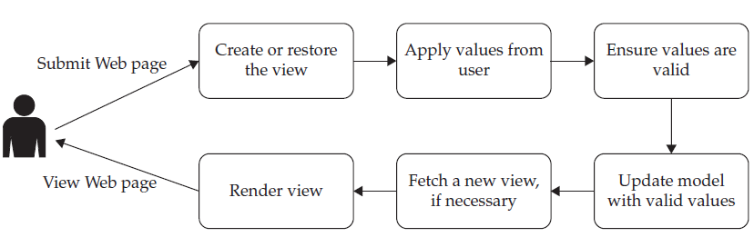
The JSF Request Processing Lifecycle

Slide 13
The JSF Navigation Model
JSF follows a Model-View-Controller design paradigm. Recall that an MVC application is segmented into three distinct application components:
The Model, which contains the business logic or non-UI code
The View, which is all the code necessary to present a UI to the user
The Controller, which is a front-end agent that directly handles the user’s requests and dispatches the appropriate view

Slide 14
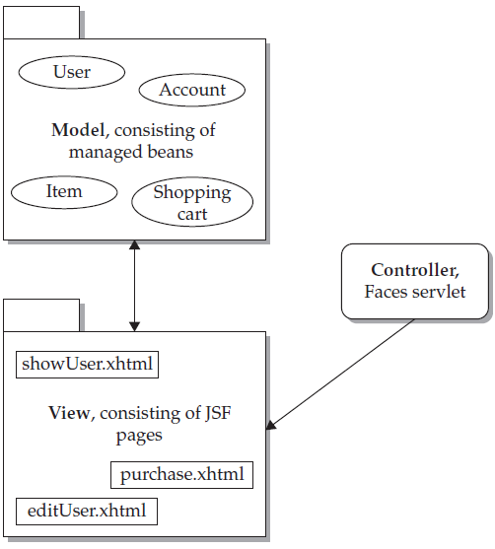
The JSF Navigation Model

Slide 15
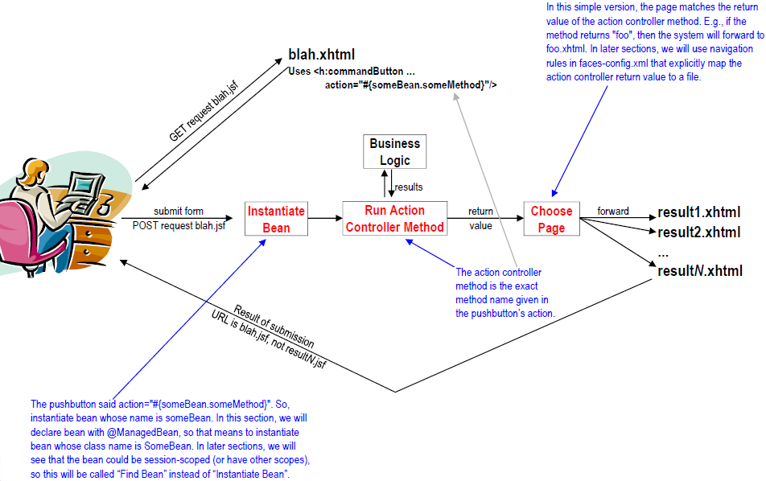
Basic Structure of JSF 2.0 Application – JSF flow

Slide 16
Basic structure of JSF Page
<?xml version="1.0" encoding="UTF-8"?>
<!DOCTYPE html PUBLIC "-//W3C//DTD XHTML 1.0 Transitional//EN"
"http://www.w3.org/TR/xhtml1/DTD/xhtml1-transitional.dtd">
<html xmlns="http://www.w3.org/1999/xhtml"
xmlns:ui="http://java.sun.com/jsf/facelets"
xmlns:h="http://java.sun.com/jsf/html"
xmlns:f="http://java.sun.com/jsf/core">
<h:head>
</h:head>
<h:body>
<h:form>
</h:form>
</h:body>
</html>

Slide 17
Basic Structure of Managed Beans
- Managed beans are Java classes that are declared with
@ManagedBean.
- They have pairs of getter and setter methods corresponding to each input element in the form.
- They have an action controller method that takes no arguments and returns a String. This is the method listed in the action of the h:commandButton in the input form.
@ManagedBean
public class SomeBean {
private String someProperty;
public String getSomeProperty()
public void setSomeProperty()
public String actionControllerMethod()
// Other methods
}

Slide 18
@ManagedBean Basics
@ManagedBean annotation
@ManagedBean
public class SomeName { … }
You refer to bean with #{someName.blah}, where bean name is class name (minus packages) with first letter changed to lower case. Request scoped by default.
And “blah” is either an exact method name (as with action of h:commandButton), or a shortcut for a getter and setter method (as with value of h:inputText).
Return values of action controller method
If action controller method returns "foo" and "bar" and there are no explicit mappings in faces-config.xml, then results pages are foo.xhtml and bar.xhtml, From same folder that contained the form

Slide 19
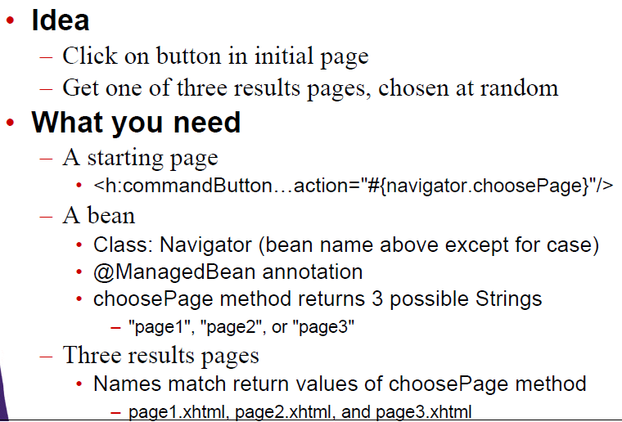
Example

Slide 20
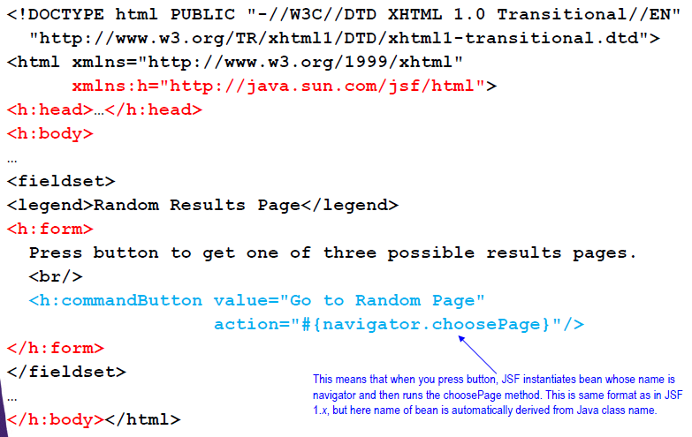
start-page.xhtml

Slide 21
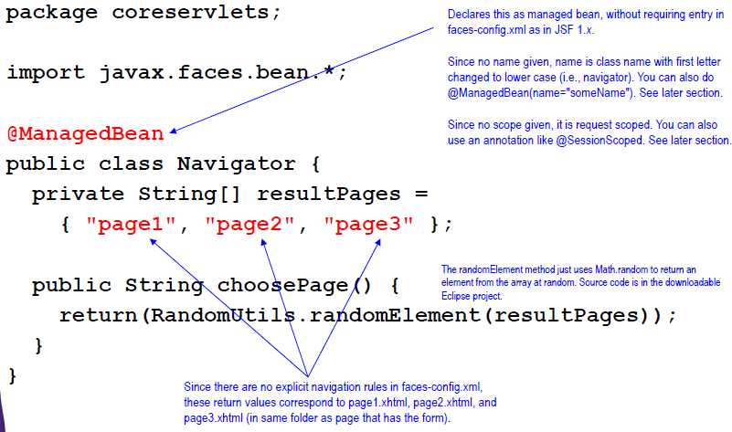
Navigator.java

Slide 22
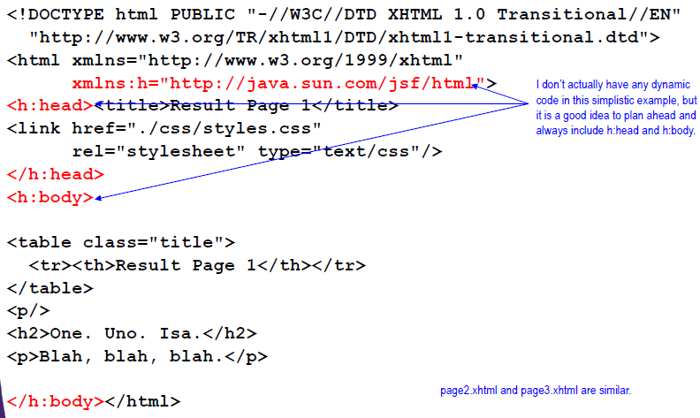
page1.xhtml

Slide 23
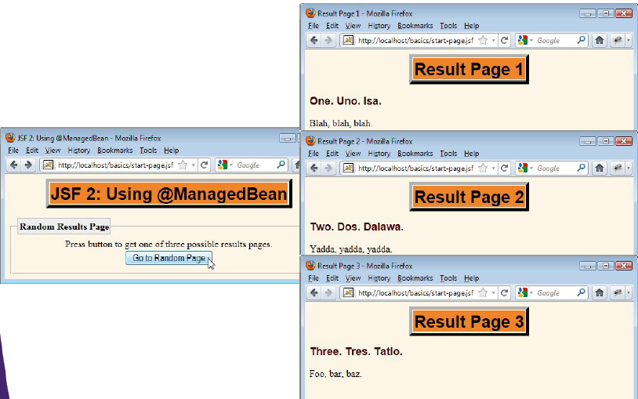
Results

Slide 24
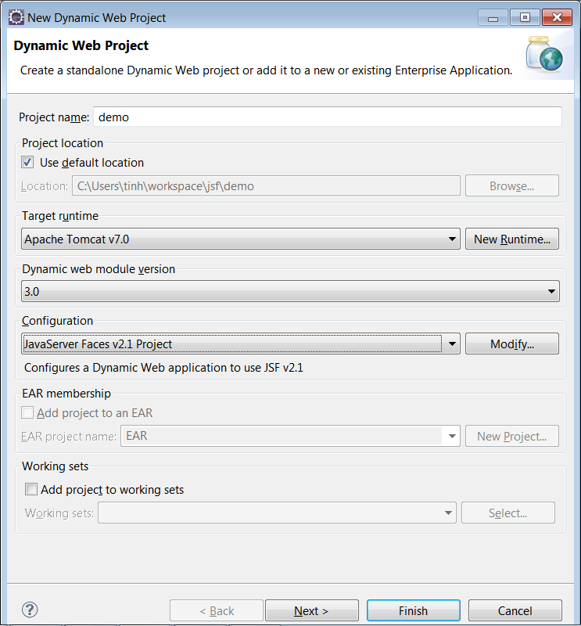
Create First JSF Project
File → New → Dynamic Web Project
Specify Apache Tomcat v6.0 as Target Runtime
Dynamic web module version: 3.0
Configuration: JavaServer faces v2.1

Slide 25
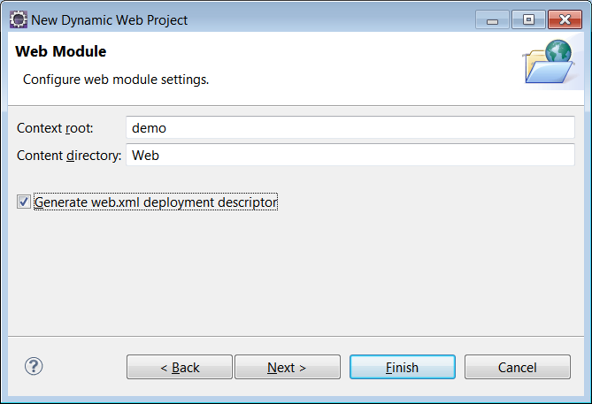
Create First JSF Project
Next – Next into web module setting

Slide 26
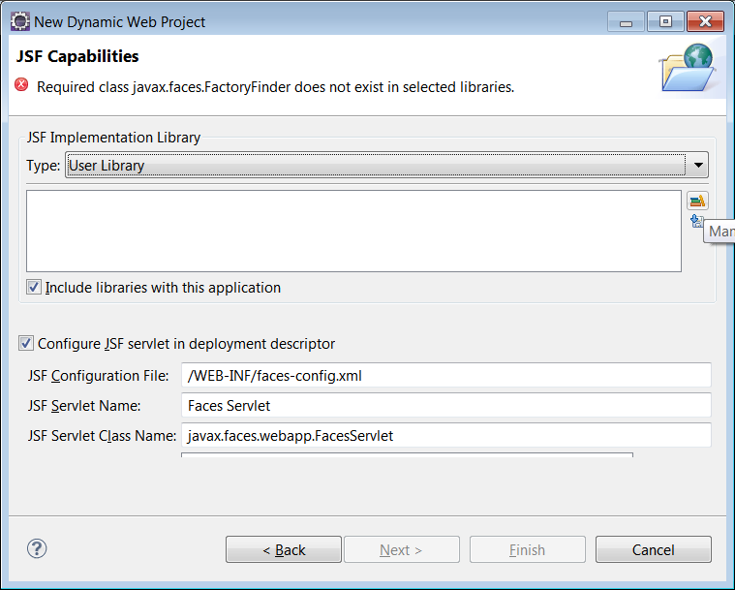
JSF Capabilities – Manage Libraries
JSF Capabilities – Manage Libraries

Slide 27
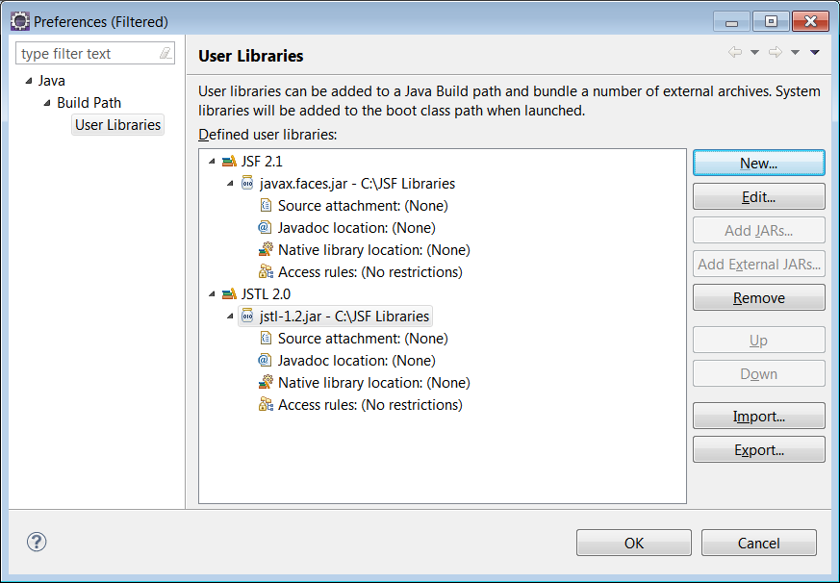
Manage Libraries
New JSTL 2.1 and JSTL 2.0, add external JARs

Slide 28
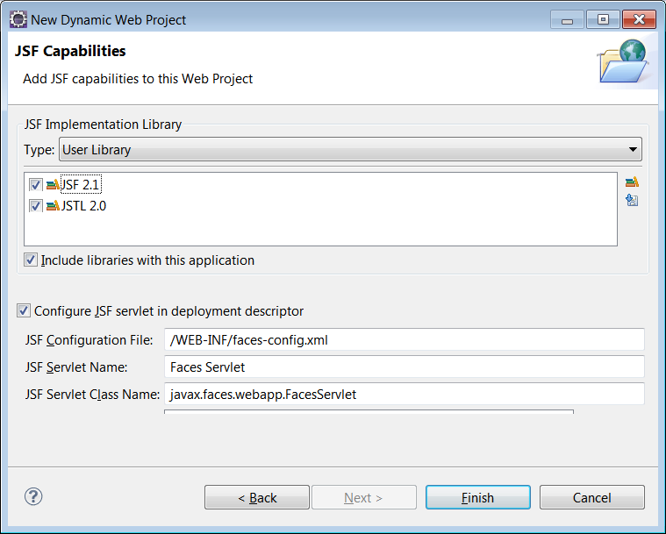
Manage Libraries
Choose 2 Libraries and finish

Slide 29
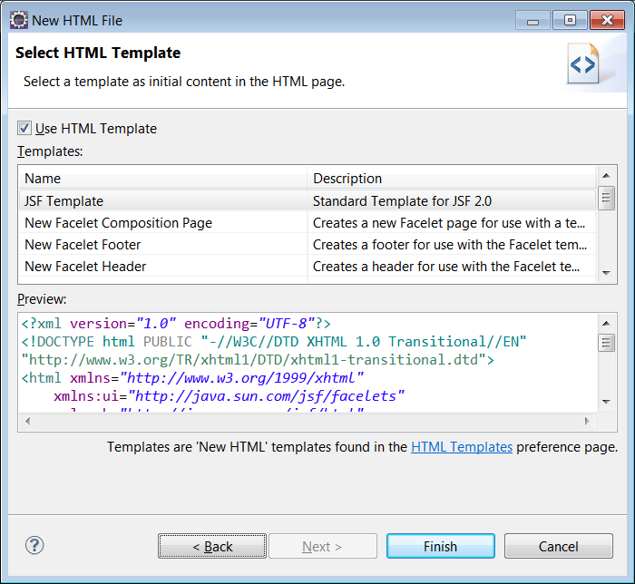
Create JSF template
R-Click on webcontent – new – html file (đặt tên file có đuôi là .xhtml) – next – press HTML Template

Slide 30
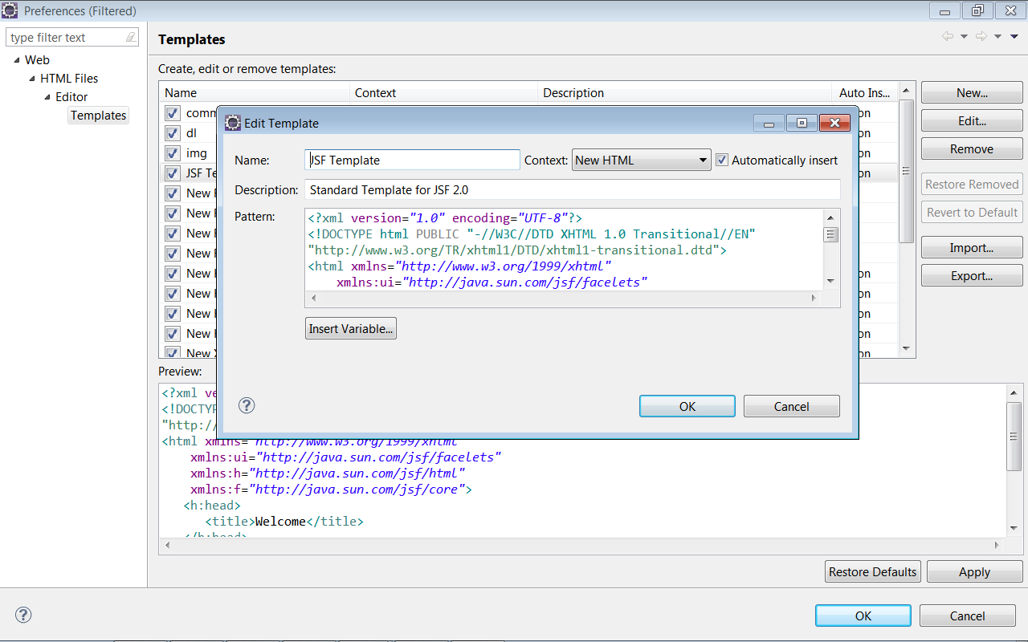
Create JSF template
Press New (đặt tên + nôi dung template)

Slide 31
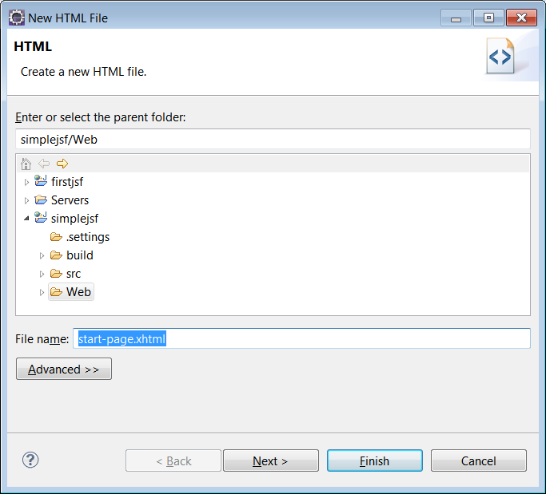
Create JSF Page
R-Click on webcontent – new – html file (đặt tên file có đuôi là .xhtml)

Slide 32
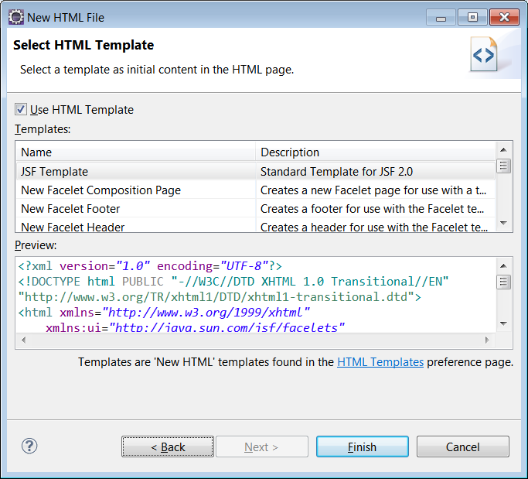
Create JSF Page
Press Next – Choose Template – Press Fisish

Slide 33
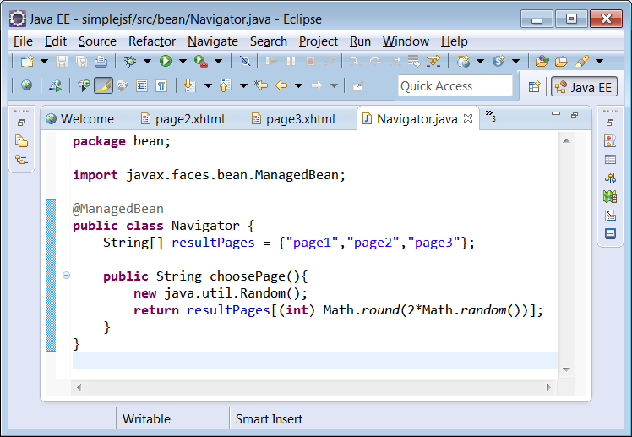
Create bean
R-Click Java Resource – new class

Slide 34
Setting default page
... <servlet-mapping> <servlet-name>Faces Servlet</servlet-name> <url-pattern>*.xhtml</url-pattern> </servlet-mapping> <welcome-file-list> <welcome-file>start-page.xhtml</welcome-file> </welcome-file-list>

